Slide 1


Reinforcement Learning in
Robotics
Group 19
Sara Mann - 22114085 Obili Sumaharsha- 22114062 Parvathi Nair - 22115115
Siya Arora- 22114093
Sadineni Chaitanya- 22114082

Slide 2


Overview
01
Introduction and Workflow
02
Significance
03
Technical
Socio-Economic
Ethical
Challenges
Model Free
Model Based
Hybrid
Hierarchical
Sim to Real Transfer
04
Existing Approaches
05
Open Problems and Future
Scope

Slide 3
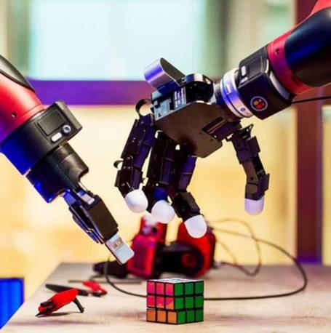
Introduction
Focuses on enabling robots to learn behaviors through trial and error, rather than being explicitly programmed.
A robot, environment,
acting can
within an
improve its
performance over time by receiving feedback from its actions, in the form of rewards or penalties.
The training data thus is generated in
an interactive process of exploration and exploitation.

Slide 4
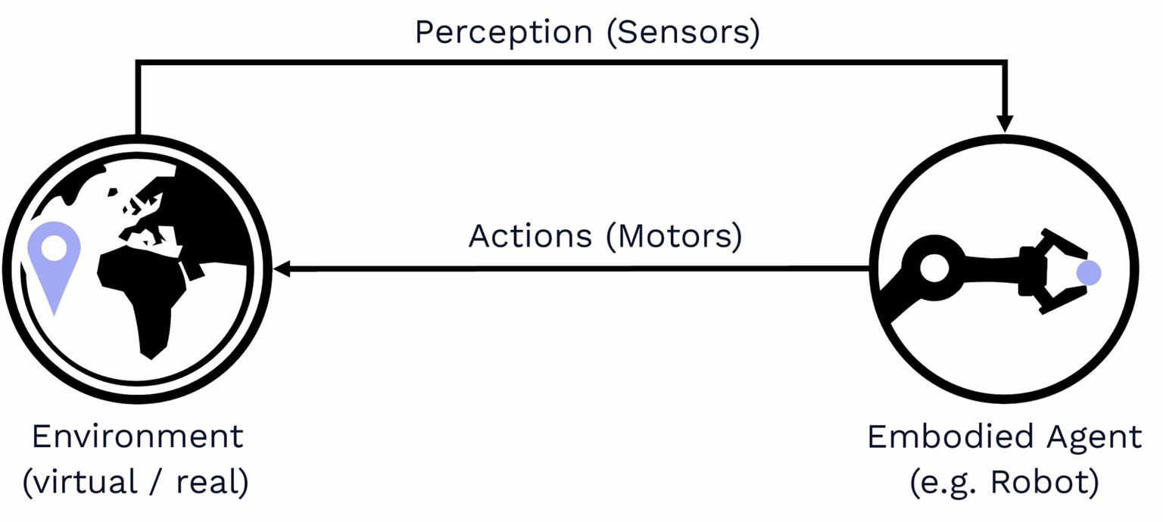
Workflow - How Robots Learn to Act
The overall RL workflow can be seen as an iterative learning process due to sensorimotor activity of an agent with an environment – a natural and very similar perspective of how we humans learn too!

Slide 5
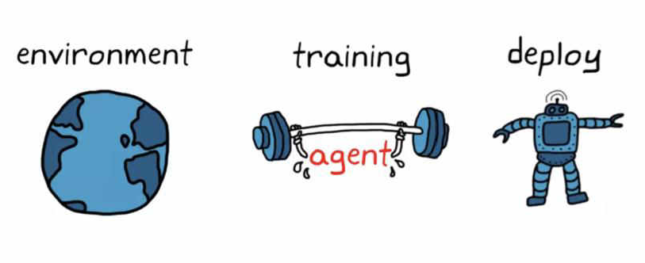
Workflow
RL is deeply intertwined with
the environment in which the robot operates
the training phase where the robot learns to interact
with this environment
the deployment phase where the learned behaviors are put into practice

Slide 6
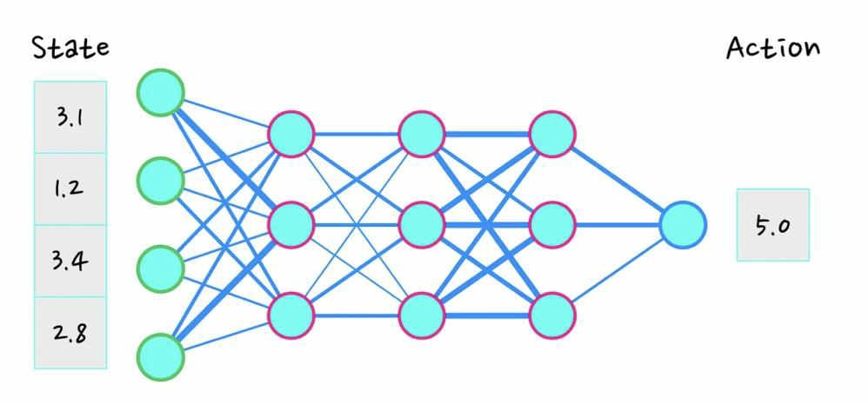
Environment
The environment in RL is the external system or world in which the
robot operates.
It includes everything the robot interacts with, from physical objects to the surrounding space and other agents (robots, humans, etc.).
State Space
Dynamics
Rewards

Slide 7
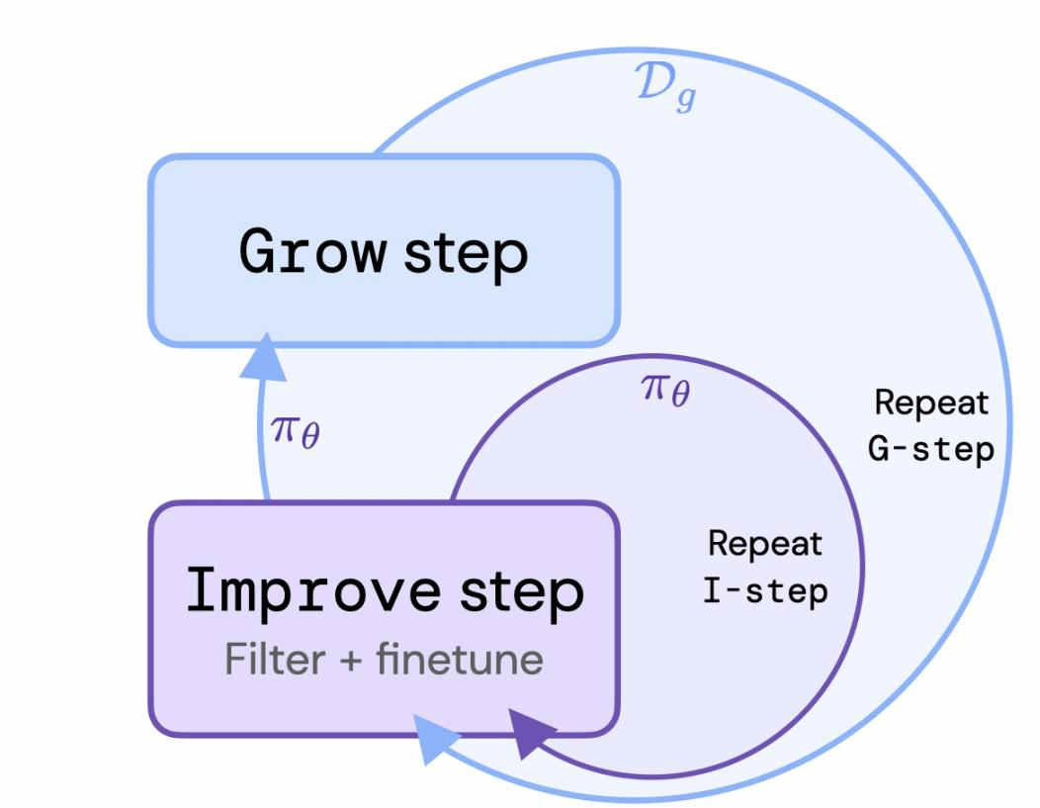
Training
Training is the phase where the robot learns to perform tasks by interacting with the environment. This phase is critical as it determines how well the robot will perform in real-world scenarios.
Simulation vs. Real-World Training
Exploration vs. Exploitation
Sample Efficiency

Slide 8

Deployment
Deployment is the phase where the trained robot is put into operation
in its intended environment to perform tasks autonomously.
Transfer Learning
Continuous Learning
Safety and Reliability
Scalability

Slide 9
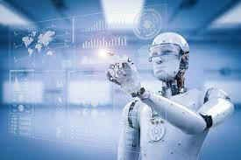
Significance
Reinforcement Learning (RL) is highly significant in robotics due to its ability to enable robots to learn and adapt to complex, dynamic environments through trial and error.

Slide 10
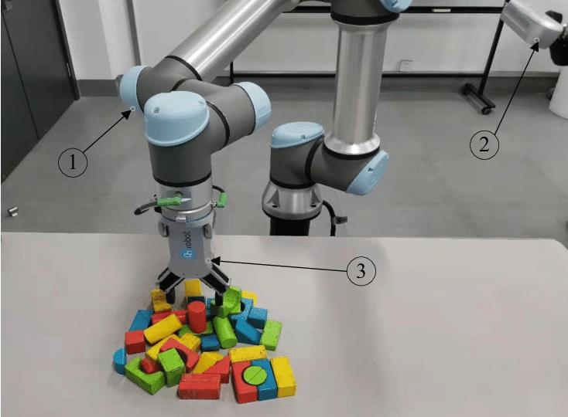
Autonomous Learning
Slglflcace:
RL allows robots to learn autonomously without needing explicit programming for every possible scenario. This is crucial for dealing with unpredictable environments and tasks.
EÖa¨e:
A robot learning to grasp objects of various shapes and sizes without human intervention.

Slide 11
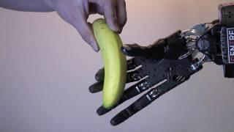
Autonomous Learning

Slide 12
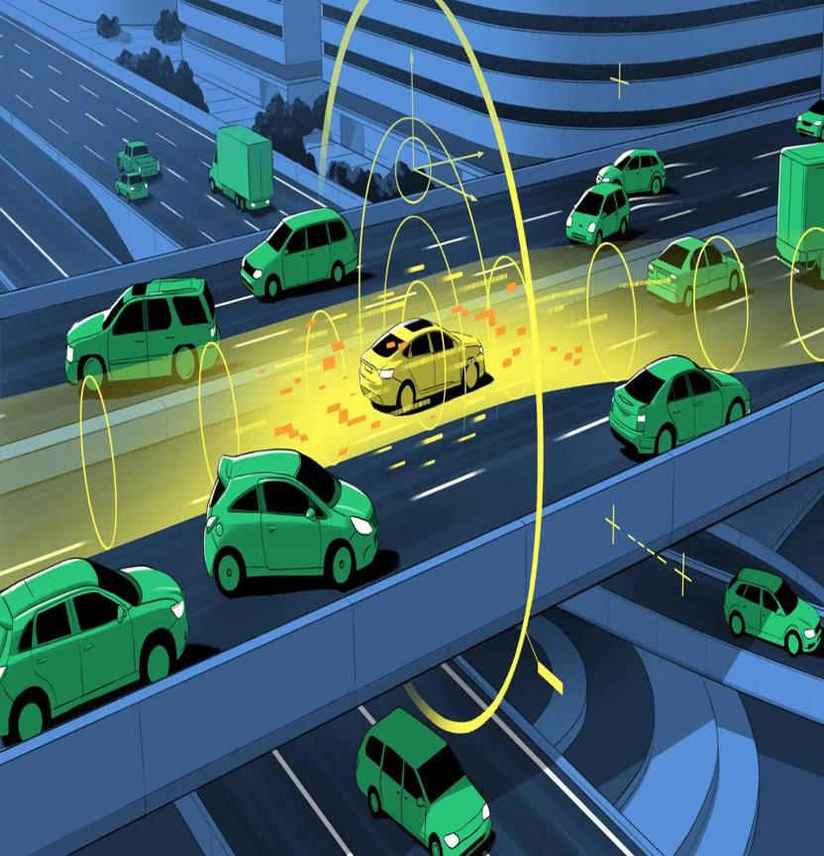
Adaptability to Complex Environments
Slglflcace:
RL enables robots to adapt to complex, real-world environments where traditional programming may fail. This adaptability is essential for tasks like navigation, manipulation, and human-robot interaction.
EÖa¨e:
Autonomous vehicles using RL to navigate through traffic and changing road conditions.

Slide 13
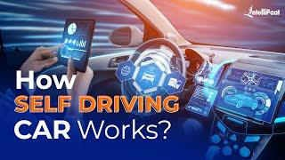
Adaptability to Complex Environments

Slide 14
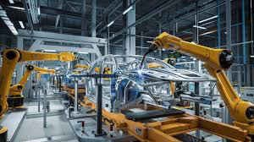
Improvement Over Time
Slglflcace:
RL allows robots to improve their performance over time as they accumulate experience. This continuous learning makes robots more efficient and effective in performing tasks.
EÖa¨e:
Industrial robots optimizing their movements and reducing the time taken to complete repetitive tasks.

Slide 15

Improvement Over Time

Slide 16

Handling Uncertainty and Variability
Slglflcace:
RL equips robots to handle uncertainty and variability in their environments, making them more robust in real-world applications.
EÖa¨e:
Robots in healthcare settings adapting to different patient needs and movements.

Slide 17
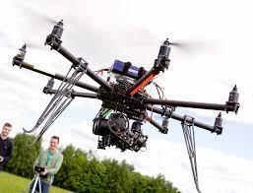
Reduced Dependency on Human
Intervention
Slglflcace:
By learning from their own experiences, robots can reduce dependency on human supervision, leading to more autonomous systems.
EÖa¨e: Drones using RL to explore and map unknown terrains without human guidance.

Slide 18
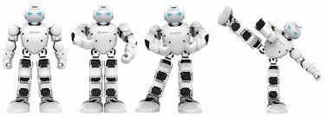
Enabling Complex Decision-Making
Slglflcace:
RL allows robots to make complex decisions in real time, considering long-term rewards rather than immediate gains. This decision- making capability is vital for strategic tasks.
EÖa¨e:
Multi-robot systems collaborating to complete a task efficiently, like search and rescue operations.

Slide 19
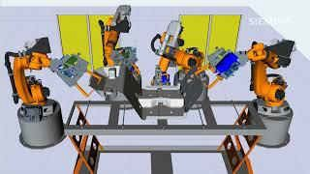
Enabling Complex Decision-Making

Slide 20
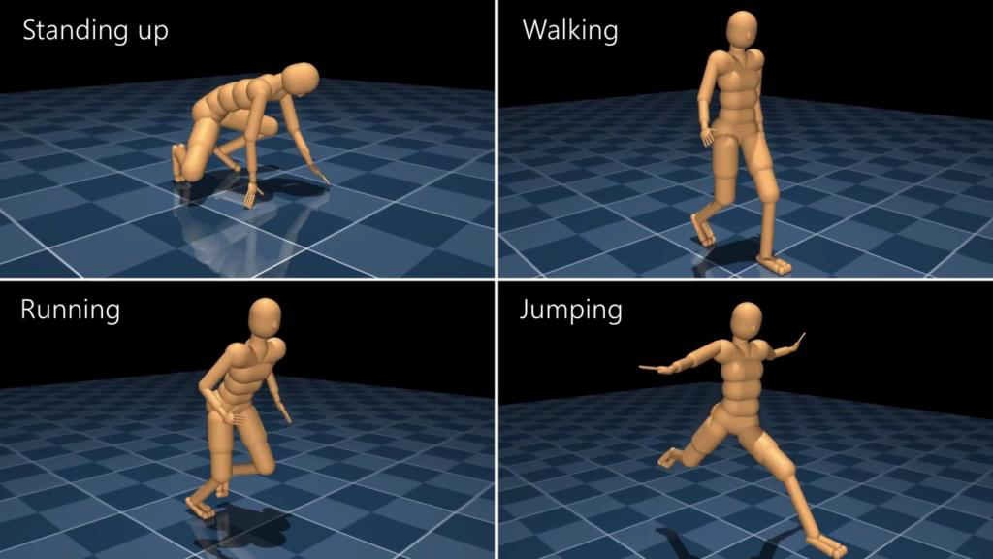
Innovation in Robotics
Slglflcace:
RL drives innovation in robotics, opening up new possibilities for robot capabilities, such as advanced locomotion, human-like dexterity, and intelligent interaction.
EÖa¨e:
Humanoid robots learning to walk, run, and jump over obstacles, mimicking human movements.

Slide 21
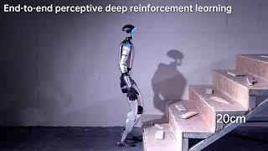
Innovation in Robotics

Slide 22
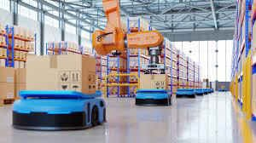
Economic and Social Impact
Slglflcace:
RL contributes to the economic and robotics by enabling robots to perform complex automation in industries like manufacturing, heallogistics.
EÖa¨e:
Warehouse robots optimizing the pickiprocess, reducing costs and improving efficiency.

Slide 23

Economic and Social Impact

Slide 24


Challenges
Technical

Slide 25




Technical Challenges - Performance
Misaligned Rewards Cause Unintended Behaviors
Poorly designed rewards can lead RL agents to adopt suboptimal or unintended strategies by reinforcing incorrect actions.
01
Agents may mistake unsuccessful behaviors for success when rewards are too frequent or misplaced.
Frequent but Misplaced Reinforcement
02
When rewards are rare or difficult to achieve, RL agents may struggle to learn the correct strategies.
03
Sparse Rewards
Hinder Learning

Slide 26

Technical Challenges - Amount of Data
RL requires millions of interactions, demanding significant time and resources.
01
Resource-Intensive RL
Training
02
Simulated Training Environments
Virtual environments allow agents to
learn without physical limitations.
Generating diverse virtual environments to match real-world conditions is resource-heavy.
03
Complexity of Simulating real-World Scenarios

Slide 27

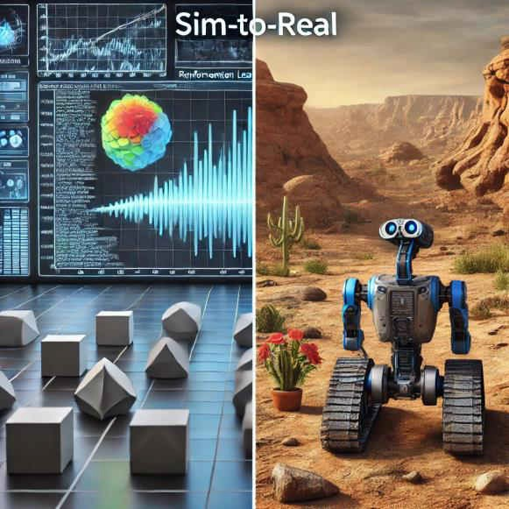

Technical Challenges - Sim-to-Real Gap
Simulations are simplified versions of the real world and differ in key aspects.
Limitations of Simulations vs. Reality
01
The accuracy of robot behavior in simulations depends on models that may not fully reflect
real-world complexities.
Inaccurate Modeling of Kinematics and Dynamics
02
Simulated sensors, communication, and lack of hardware failures create differences from real-world interactions.
03
Perception and Interaction Gap

Slide 28

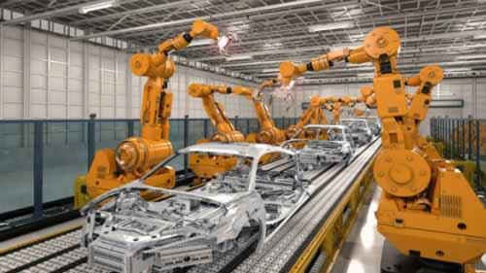

Socio-Economic Challenges - Job Displacement
RL-powered robotics can take over tasks currently performed by humans, such as assembly line and warehouse work.
01
Automation of
Human Tasks
The rise of automation could lead to job displacement, particularly in manufacturing and logistics.
02
Impact on Job Markets
Increased automation may exacerbate economic inequality, especially in industries heavily reliant on human labor.
Worsening Economic Inequality
03

Slide 29

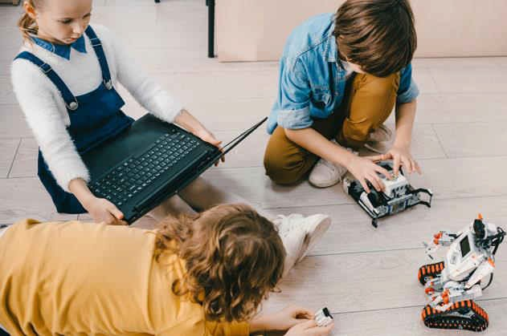


Socio-Economic Challenges - Skill Gap
Advanced robotics integration demands a workforce skilled in robotics, machine learning, and AI.
01
Need for
Specialized Skills
Education and training in robotics and AI are often restricted to affluent regions and institutions.
02
Limited Access to Education
Limits opportunities for talent in underserved areas, exacerbating socio- economic inequality.
03
Widening Socio- Economic Gap

Slide 30


Socio-Economic Challenges - High Development Costs
Developing RL-powered robotics demands substantial financial and technological investment.
Smaller companies and developing countries face difficulties in competing due to resource constraints.
High adoption costs make it hard for small enterprises to embrace RL, limiting innovation and competition in the market.
01
High Resource Requirements
02
Challenges for Smaller Players
03
Barrier to Innovation

Slide 31

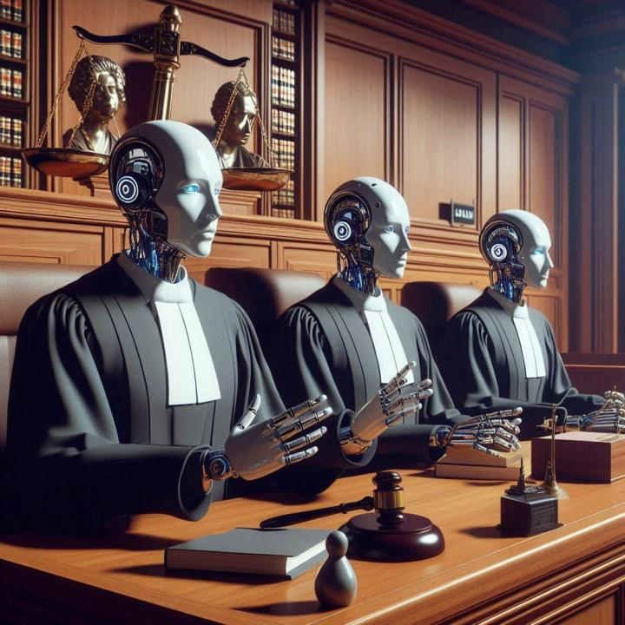


Ethical Challenges - Bias and Fairness
RL systems can inherit and amplify biases present in their training data.
01
Amplification of Biases
Biased RL systems can lead to unfair outcomes in fields like criminal justice, healthcare, and finance.
Severe Consequences in Critical Areas
02
The decision-making processes of RL systems are often unclear, complicating the identification and mitigation of biases.
03
Opaque Decision-
Making

Slide 32

Ethical Challenges - Trust and Social Acceptance
RL systems require extensive personal data, raising concerns about misuse and identity theft.
01
Data Privacy Risks
Using RL in public safety can lead to increased surveillance and potential privacy invasions.
RL systems might be repurposed beyond their original intent, such as unauthorized tracking of individuals.
02
Surveillance Concerns
03
Potential Misuse in Public Safety

Slide 33


Ethical Challenges - Risk of Malfunction
RL-driven robots learn by trial and error, which can lead to potentially dangerous errors
RL algorithms may malfunction if the real-world conditions differ from the training environment.
Determining responsibility for mistakes, especially in critical areas like autonomous driving, can be challenging.
01
Risk of Dangerous Mistakes
02
Sensitivity to
Environmental Changes
03
Accountability Issues

Slide 34
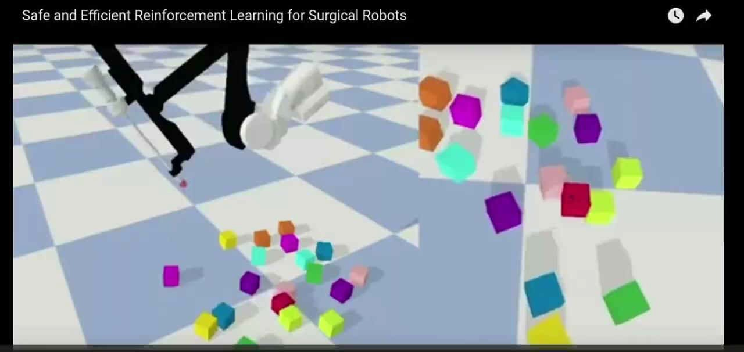
Video Demonstrating RL in Surgical Robots

Slide 35
Existing Approaches
Q-Learning
Deep Q-Learning
Policy Gradient Method
Dynamics Model Learning
Model Predictive Control
Actor-Critic Method
Guided Policy Search
01
Model-Free Approaches
02
Model-Based Approaches
03
Hybrid Approaches
04
Hierarchical Approaches
Hierarchical Reinforcement Learning
05
Sim-to-Real Transfer
Domain Randomization
Domain Adaptation

Slide 36
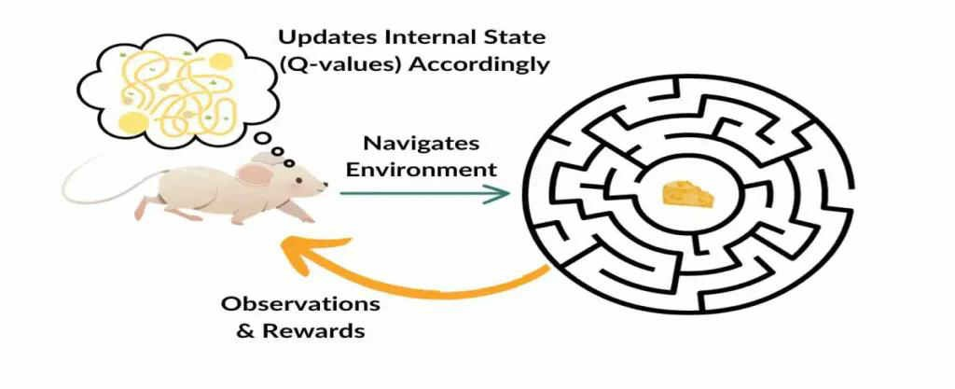
Model-Free Approaches: Q-Learning
Explore
Learn from Rewards
Q-Learning works very well for small, discrete environments.
The agent tries different actions in each state to gather information.
After each action, the agent receives a reward (positive or negative).
Example : Simple Navigation
Update Q-values
Optimize Over Time
The agent updates its Q-table, which stores expected rewards (Q- values) for each action in each state.
By repeating this process, the agent learns which actions yield the highest future rewards.

Slide 37
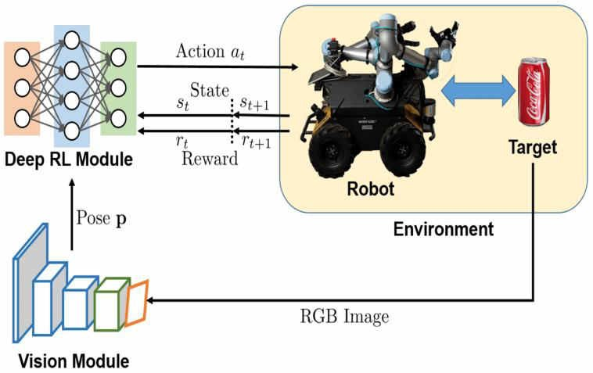
Model-Free Approaches: Deep Q-Learning
Neural Network as Q- Function
Experience Replay
Deep Q-Learning works well when handling complex inputs like images and sensor data
Past experiences are stored and randomly sampled for training to improve stability.
A neural network (DQN) predicts Q- values for each action
Example: Image Based Control
Target Network
Optimize Over Time
A separate network provides stable Q-value updates, helping with convergence.
The DQN refines Q- values with each batch of experiences to improve decision making.

Slide 38
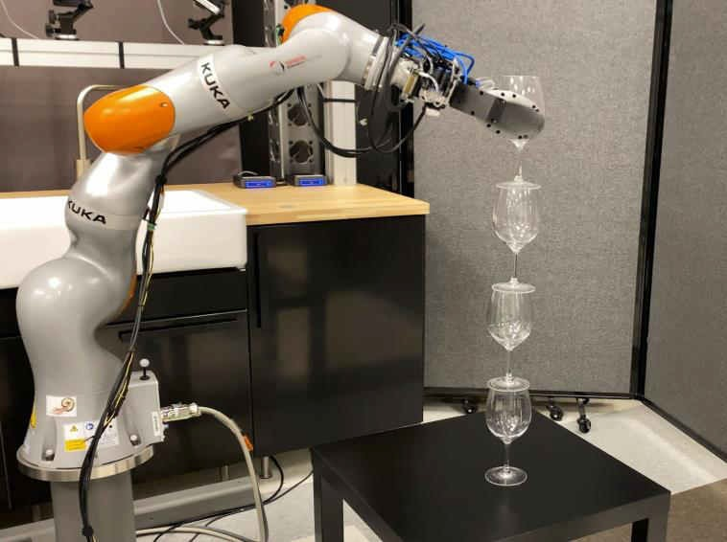
Model-Free Approaches: Policy Gradient
Method
Learn a Policy (π)
Use Rewards to
Update Policy
The ¨lc× (π) l¯ a neural network that maps states to actions to maximize long-term rewards.
Policy Gradient Methods are ideal for fine motor control tasks
After each action, rewards adjust the policy to favor successful actions.
Example: Grasping an Object
Gradient Ascent
Optimize Over Time
The agent updates the policy using gradient ascent to increase expected rewards
Repeated experiences improve the policy for better decision making.

Slide 39
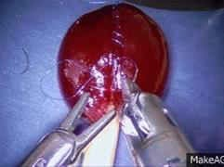
Model-Based Approaches: Dynamics Model
Learning
Learn the Dynamics Model
Use Predictions for
Planning
Dynamis Model Learning is ideal for tasks in environments where trial and error is risky or expensive.
The model learns to predict the next state from the current state and action.
The agent uses the
de’¯ ¨«edlc·l¯ ·
plan future actions.
Example: Robotic Surgery
Improve the Model Over Time
Optimize Policy Using the Model
The model is updated with new data for more accurate predictions.
The agent uses the model to improve its policy and choose better actions.

Slide 40
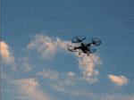
Model-Based Approches: Model Predictive
Control (MPC)
Model the System
Plan Actions for the
Future
MPC is very useful for real- time applications where the robot has to adjust to changing conditions quickly
A model predicts how the system will behave over time based on current actions.
The agent predicts future states and selects actions to optimize
long-term
performance.
Example: Drone Navigation
Solve an Optimization Problem
Optimize Policy Using the Model
MPC solves an optimization problem to find the best actions for the next time steps.
The agent uses the model to improve its policy and choose better actions.

Slide 41

Hybrid Approaches: Actor-Critic Method
Actor Chooses Actions
Critic Evaluates
Actions
Actor-critic methods have been applied successfully in continuous control tasks.
The Actor selects actions based on the current policy.
The Critic estimates the value of the selected action and provides feedback.
Example: Handwriting Tasks
.
Optimize Over Time
Update Actor and Critic
The Actor improves its policy using feedback from the Critic. The Critic updates its value estimates based on new experiences.
Both the Actor and Critic are updated over time, leading to better action selection and evaluation.

Slide 42
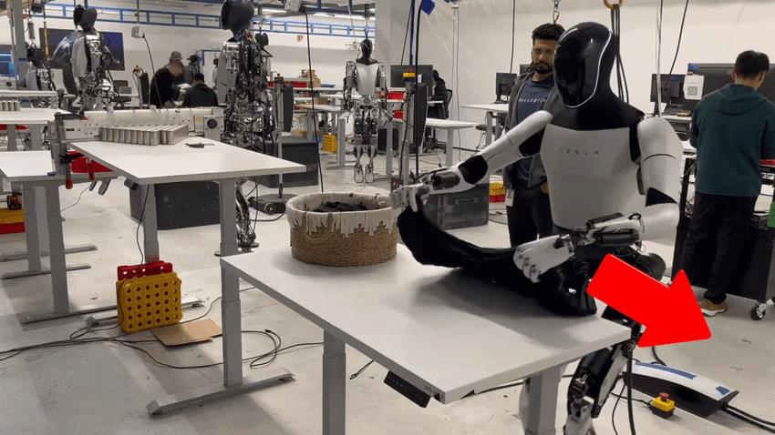
Hybrid Approaches: Guided Policy Search
Train a Candidate Policy
Use Reinforcement
Learning to Refine
Guided Policy Search stabilizes and speeds up training, especially in tasks requiring precise control
A candidate policy is trained using supervised learning on simulated data to act like a good policy.
The candidate policy is fine-tuned using reinforcement learning by interacting with the environment.
Example: Folding Clothes
Guided Updates
Iterative Improvement
The policy is updated by guiding it towards better actions using gradients from both the environment and simulations.
.
The policy improves iteratively as it gets better at acting in the real environment through the combined methods.

Slide 43
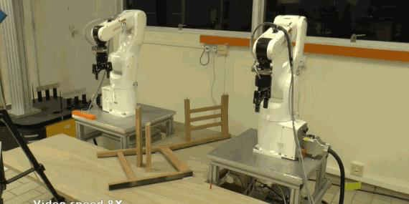
Hierarchical Approaches: Hierarchical
Reinforcement Learning (HRL)
Decompose the Task
High-Level Policy
HRL is particularly useful in robotics applications involving multi-step processes or long- term planning
The main task is broken into smaller sub-tasks, each with its own goal.
A high-level policy selects which sub-task to focus on based on the current situation.
Example: Assembling Furniture
Low-Level Policies:
Hierarchical Learning:
.
The agent learns both
the high-level and low- level policies, optimizing them over time.
Each sub-task has its own low-level policy that solves the specific goal.

Slide 44
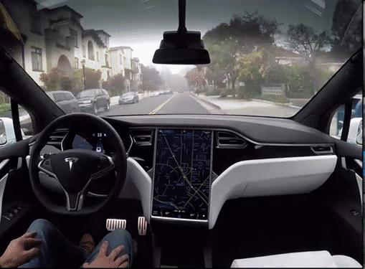
Sim-to-Real Transfer: Domain Randomization
Randomize Environment Variables
Train in Diverse
Conditions
Domain Randomization is used for tasks where the robots need to perform well across a wide range of real- world conditions
The eÐl«e·’¯ properties are varied randomly during training.
The agent learns to perform tasks in different simulated settings, improving generalization.
Example: Autonomous Driving
Transfer to Real World
Improve Robustness
The trained agent is tested in the real world, where it can adapt to various unknown conditions.
By training under many different conditions, the agent becomes more robust and adaptable to real- world variability.

Slide 45

Sim-to-Real Transfer: Domain Adaptation
Train in Source Domain
Adapt to Target
Domain
Domain Adaptation is useful for tasks where a model trained on one domain needs to be adapted to work effectively in a different, but related domain
The model is first trained in a source domain (e.g., simulations) with abundant labeled data.
The model is then adapted to the target domain where labeled data may be scarce.
Example: Industrial Automation
Transfer Knowledge
Fine-Tune on Target
Data
Knowledge from the source domain is transferred to help the model perform well in the target domain.
The model is fine-
tuned on available
.
target domain data to
improve its
performance.

Slide 46



Open Problems
Learning with Limited interactions
Reducing training interactions is essential in RL, especially for costly, time-intensive real-world robotics.
01
I¨«Ðlg RL’¯ }Ñedge ·«a¯fe« from simulation to real-world robots enhances practical application.
02
Sim-to-Real Transfer
Real-world environments are complex and unpredictable, requiring advanced RL methods to adapt effectively is still a significant challenge.
03
Environment Complexity

Slide 47

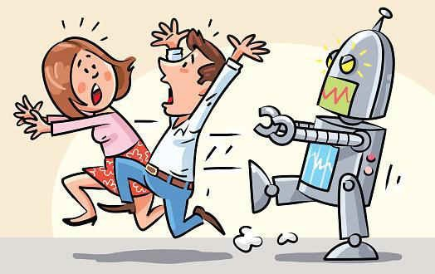

Open Problems
Ensuring RL in robots prevent harmful actions and maintain reliable performance across diverse, real-world conditions.
04
Safety and Robustness
Enhancing RL in robots to learn effectively from fewer interactions, using methods like experience replay to maximize data use.
05
Data Efficiency
im
ited
Addressing the challenge of scaling RL algorithms to manage complex robotic systems with high-dimensional actions and observations.
06
Scalability

Slide 48

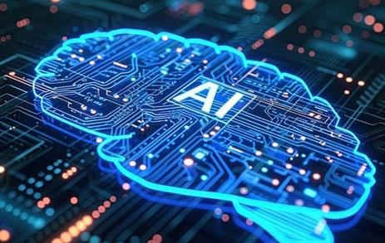

Future Scope
Combining reinforcement learning (RL) with AI fields like computer vision, NLP, and symbolic reasoning to enhance robot capabilities.
01
Integration with AI Technologies
Using predictive models to increase decision-making efficiency and reduce sample reliance in RL systems.
02
Model-Based RL
Developing RL algorithms that dynamically adjust to environmental or task changes, enhancing robot adaptability
03
Adaptive
Learning Systems

Slide 49

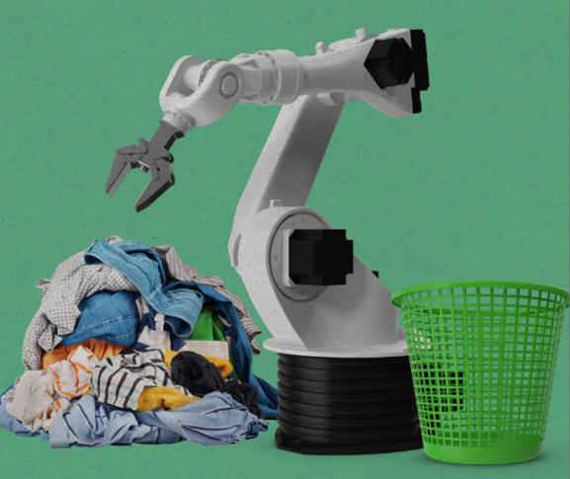


Future Scope
Designing RL systems that align with human goals and behaviors, improving usability and effectiveness in real- world scenarios.
04
Human-Centric
Design
Creating RL robots that adapt to individual user preferences, enhancing personalized applications.
Personalization and Customization
05
Developing
Robot using reinforcement learning to tackle laundry sorting, bringing automation closer to everyday household chores.
computationally efficient RL algorithms for deployment on resource-limited platforms, enabling broader application in robotics.
06
Resource Efficiency

Slide 50
References
https://lamarr-institute.org/blog/reinforcement-learning- and-robotics/
https://link.springer.com/article/10.1007/s10462-021-
09997-9
https://www.geeksforgeeks.org/model-free- reinforcement-learning-an-overview/
https://towardsdatascience.com/policy-gradient-step-by-
step-ac34b629fd55
https://openai.com/index/openai-baselines-ppo/
https://jonathan-hui.medium.com/rl-model-based-
reinforcement-learning-3c2b6f0aa323
https://iopscience.iop.org/article/10.1088/1742- 6596/1748/2/022039/pdf

Slide 51
References
https://towardsdatascience.com/hierarchical- reinforcement-learning-56add31a21ab
https://30dayscoding.com/blog/deep-reinforcement-
learning-robotics-sim-to-real-transfer-learning
https://www.youtube.com/watch?v=YXalVenVqvU

Slide 52
Thank You

